Slide 1





OBINexus BCI: Neurodivergent Communication Revolution
2025/10/29
OBINexus

Slide 2

CONTENTS
01
02
03
The Communication Crisis
Core Innovation
Technical Implementation
04
03
06
Safety & Ethics
Relay Therapy System
Development & Access

Slide 3



CONTENTS
01
Integration & Impact
02
Call to Action

Slide 4


01
The Communication Crisis

Slide 5

OBINexus BCI
Neurodivergent Communication Revolution
A zero-latency brain-computer interface with relay therapy, enabling authentic self-expression for the severely neurodivergent through pre-conscious(200ms - 300ms) neural detection and a constitutional governance framework.

Slide 6
The Critical Problem: A Communication Crisis
30% of autistic individuals remain non-verbal into adulthood, left without a voice by traditional systems.
Medication-focused approaches treat symptoms but miss the core need for communication.
Current BCIs fail because they require conscious intent, which is impossible for many.
Millions are left without agency in their own care decisions.

Slide 7
The Gap Analysis
Where Current Systems Fail
Neurodivergent Mind
Traditional BCI Failure
Rich internal world, complex thoughts.
Conscious Intent Required
Cannot access pre-conscious thought.
Pre-conscious Activity
Authentic Expression
The "spark" of thought, undetected by current tech.
Lost in translation through complex interfaces.

Slide 8
02
Core Innovation

Slide 9
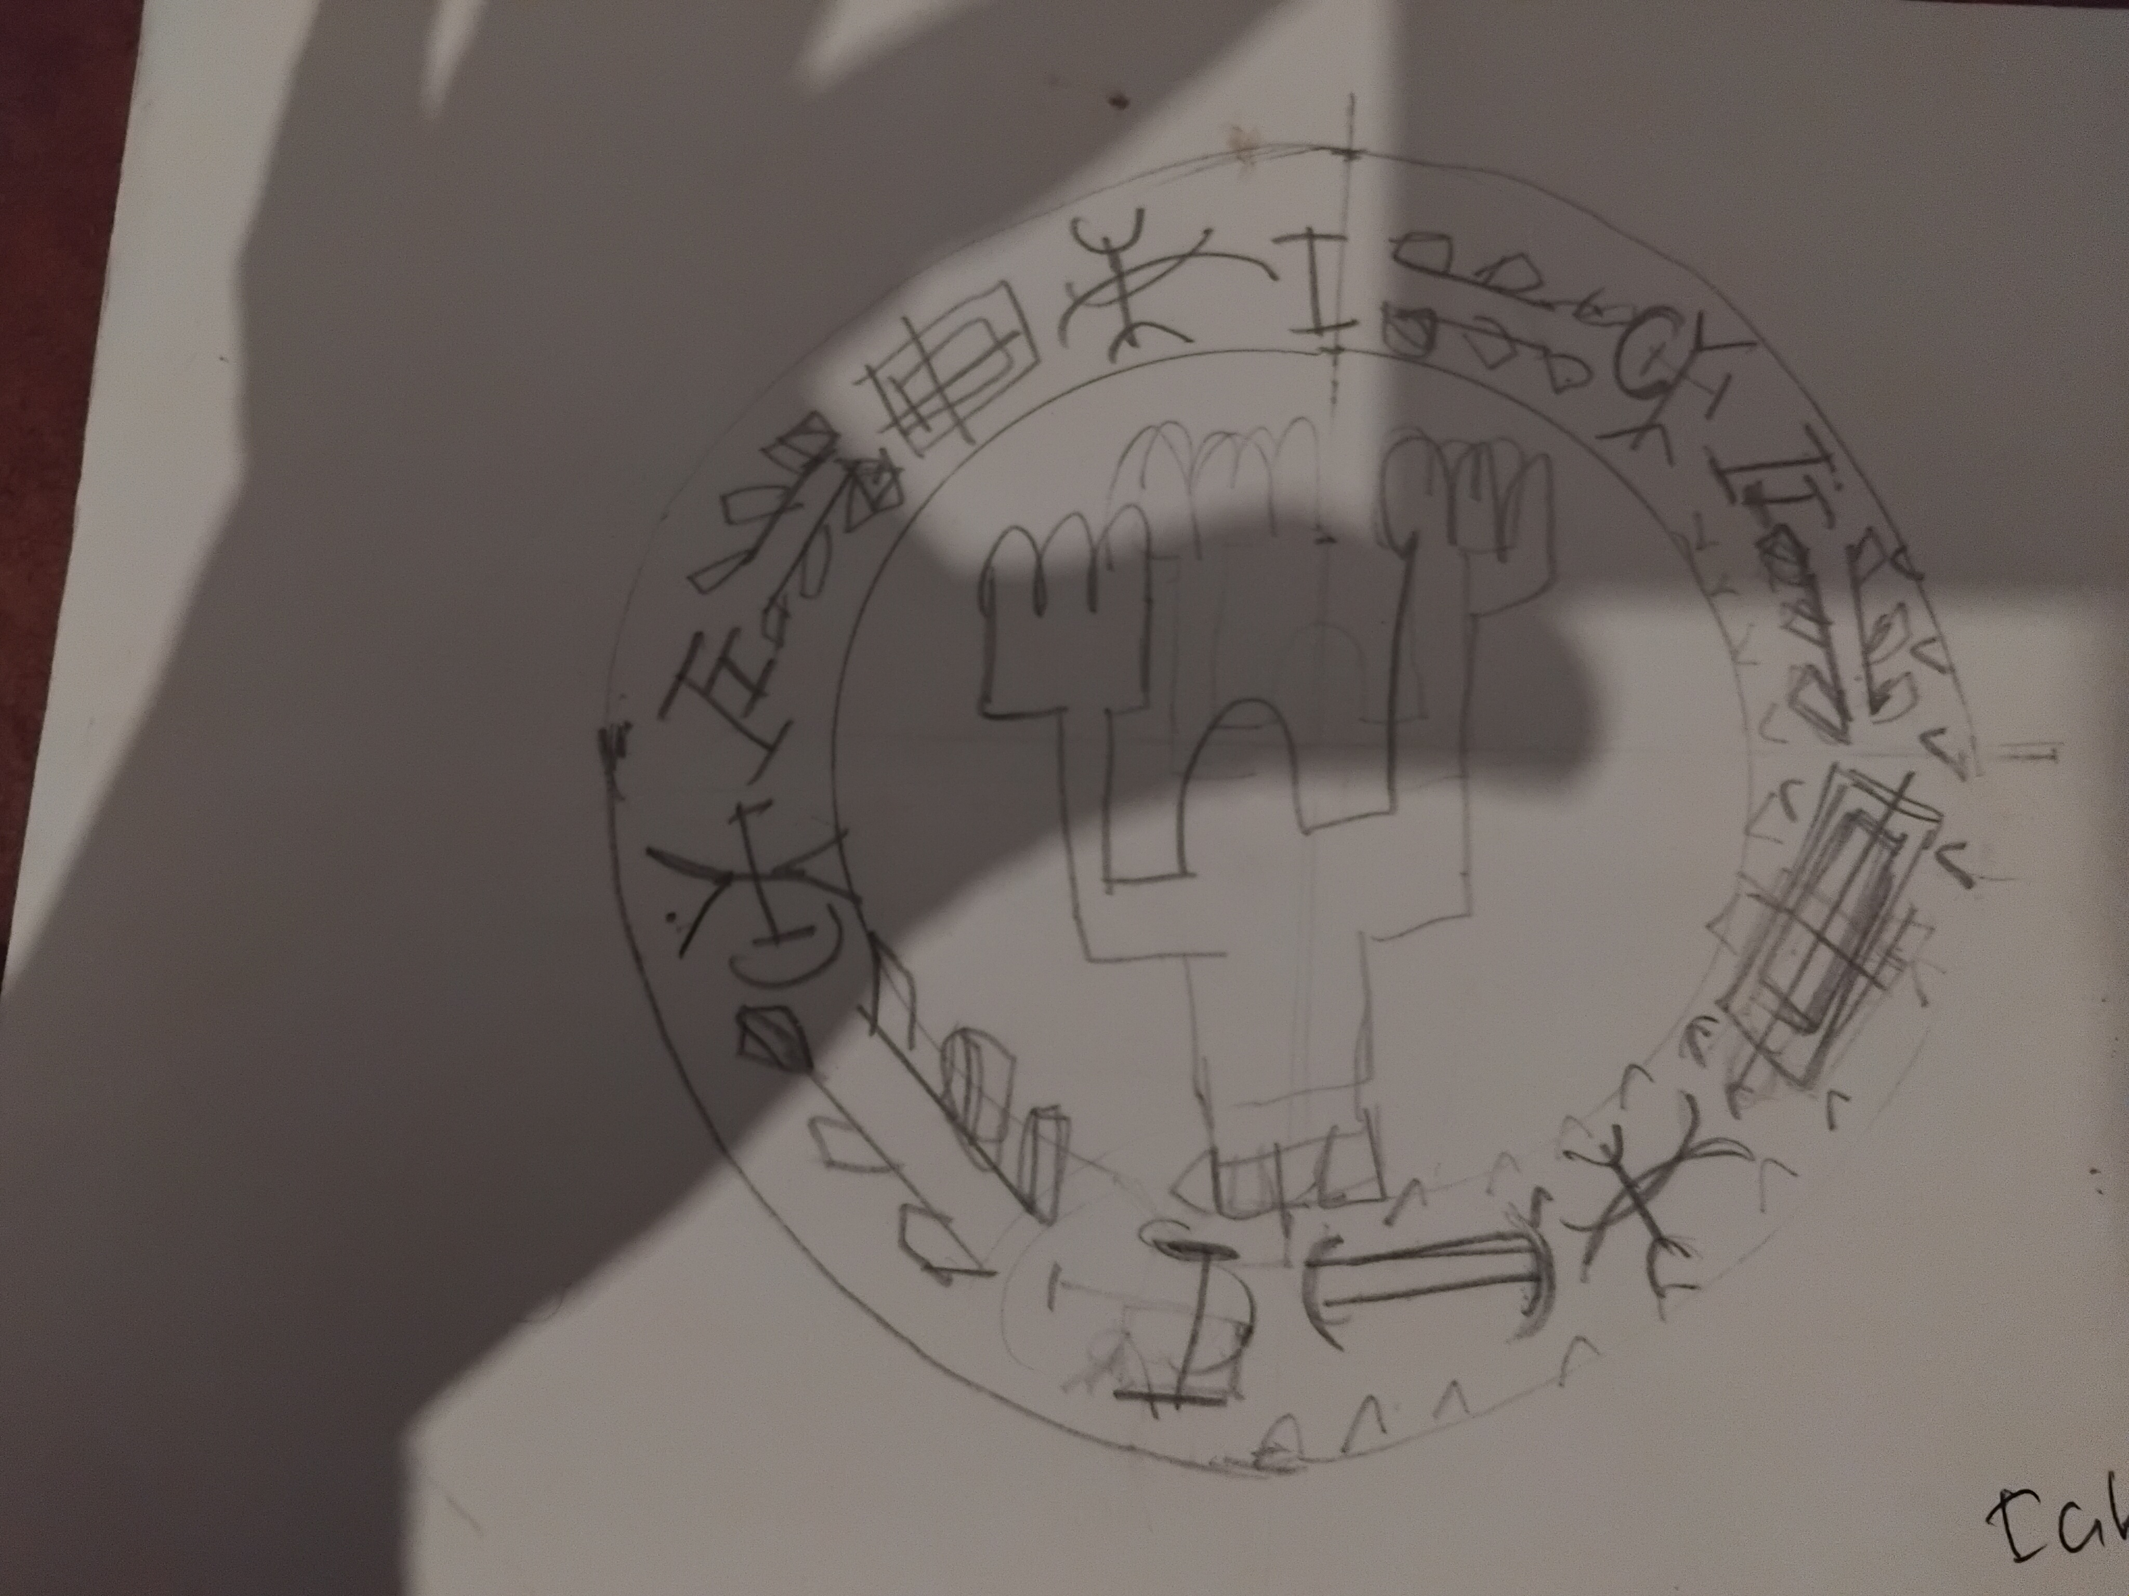
Core Innovation
Pre-conscious Detection
Our system detects the neural "spark" 200-300ms before a thought fully forms. This bypasses the need for conscious intent, making communication possible for those previously unreachable.
Visual (eze): Monitors image formation.
Knowledge (uche): Captures internal monologue.
Action Intent: Detects pre-motor activation.

Slide 10
Technical Architecture Overview
Hardware
Detection
Processing
64-channel dry EEG with 2048 Hz sampling rate.
Pre-conscious neural spark identification.
Real-time pattern recognition and intent mapping.

Slide 11
Neural Detection Framework
Three pattern types for comprehensive neural mapping.
eze (Visual)
uche (Knowledge)
Action Intent
Monitors the occipital cortex for visual image formation, detecting the brain's "visual spark."
Captures patterns of internal monologue and the activation of language centers before speech.
Detects pre-motor cortex activation, identifying the intention to move or act before it happens.

Slide 12
03
Relay Therapy System

Slide 13
The Relay Therapy System
Puppet Method Protocol
Neurodivergent Mind
BCI Detection
Puppet Expression
Authentic Feedback & Reinforcement

Slide 14

Puppet Protocol
Anti-Coercion Framework
A constitutional framework ensures the puppet is a tool for expression, not control. The user's sovereignty is the highest principle.
Puppet Control: CHILD_ONLY
Expression Rights: PRESERVED
Withdrawal: ALWAYS ALLOWED

Slide 15

Real-World Use Case
A Non-Verbal Child's Breakthrough
A 10-year-old child, completely non-verbal, with severe autism. Traditional speech therapy and AAC devices had failed for 8 years.
OBINexus Intervention (6-week protocol):
Established basic communication for hunger, bathroom, and comfort requests for the first time.

Slide 16
04
Technical Implementation

Slide 17
Session Flow Example
"Can you clean your room?" Protocol
Question
Neural Spark
Puppet Response
Binary Mapping
Reinforcement
Yes/No Pattern
Strengthens Pathway

Slide 18
Authentication Mechanism
"Who is Me(X)?, Am I Myself(Y), Who am I(Z)" Neural Signature - AuraSeal Gatable Verfication(95.4% Evolution)
Unique Neural Fingerprint
The system validates authentic expression by identifying a user's unique neural fingerprint, ensuring the communication is genuinely theirs and not externally influenced.
Constitutional Protection
Each individual's pre-conscious patterns are unique, creating a signature of their internal state.
External validation occurs within a framework that prioritizes user sovereignty, generating a "Sovereignty Score".

Slide 19
Signal Processing Pipeline
A Lossless DAG Transformation
Raw EEG
Noise Filtering
Feature Extraction
Pattern Classification
Intent Prediction
Action Mapping
Relay Output
Neural Reinforcement
Feedback Loop
End-to-end latency: <50ms

Slide 20
Pattern Recognition Architecture
Multi-Modal AI for Comprehensive Understanding
CNN-based
Decodes visual cortex activity.
Ensemble Learning
RNN-based
Recognizes internal monologue patterns.
Integrates multiple patterns for a holistic understanding of user intent.
Motor Imagery
Classifies action intention.

Slide 21
05
Safety & Ethics

Slide 22
Safety First
Ethical by Design
Medical-grade non-invasive EEG ensures user safety is the top priority.
Governance is built-in, not an afterthought, to protect user sovereignty.
IEC 60601-1 Compliant
21-Validator System
HIPAA Data Handling
70% Consensus Required

Slide 23
Anti-Coercion Framework
21-Validator Constitutional Governance
Community (8)
Parents (2)
Peers (5)
Self-Advocate
Therapists (2)
Educators (3)
70% consensus required for any major action, ensuring protection against unilateral decisions.

Slide 24

Recovery Protocols
Systematic Trust Rebuilding
If a boundary violation occurs, a clear protocol is activated to restore user sovereignty and rebuild trust in a child-directed manner.
1
Acknowledge the violation genuinely.
2
Apologize sincerely and return full control.
3
Rebuild trust slowly at the child's pace.
4
Document to prevent future violations.

Slide 25
06
Development & Access

Slide 26
Development Roadmap
An 18-month journey from concept to commercial device.
1
2
3
Phase 1 (Months 1-6)
Phase 2 (Months 7-12)
Phase 3 (Months 13-18)
8-channel wired proof-of-concept to validate core technology.
32-channel wireless system with enhanced pattern recognition.
64-channel commercial device with full regulatory approval.

Slide 27
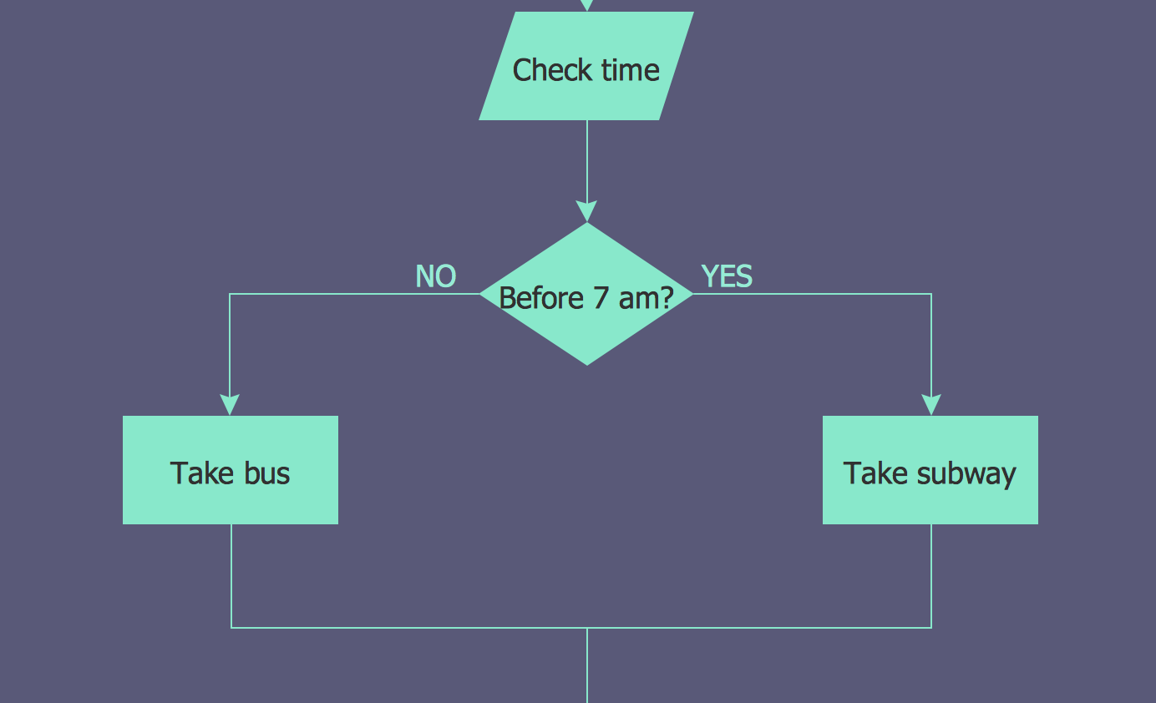
Open Source Framework
Constitutional Peer Review Infrastructure
We are building the peer review system we wish to see—one that is open, transparent, and constitutionally bound to protect innovation and user sovereignty.
When traditional systems fail to validate breakthroughs, we create our own. This is the foundation for ethical neurotech development.
Join us at:
github.com/obinexus/openpr

Slide 28
T3A Access Tiers
Open Access Research & Development
Integration Tier
Action Tier
EZE Tier
Full System
UCHE Tier
Motor Intent
Visual Processing
Knowledge Access
A progressive, responsible model ensuring open access for research while maintaining ethical development standards.

Slide 29
07
Integration & Impact

Slide 30

Persona Development Integration
From Curated to Created Identity
The framework helps users transition from a curated identity, based on external references, to a created one, arising from authentic internal experiences.
Curated Persona (External) → The Spark (Moment of Change) → Created Persona (Authentic) → Puppet Expression (Anchor)

Slide 31
Five Senses Framework Integration
Leveraging the opensense-framework
5 Senses (Input)
6th Sense (Integration)
7th Sense (Expression)
Authentic Communication

Slide 32
Binary Tier System
Foundation vs. Aspiration Tracks
Foundation Track
Aspiration Track
Basic Stability (Physiological & Psychological Needs)
Growth & Development (Belonging, Esteem, Self-Actualization)
Housing & Financial Security
Skill Development & Education
Mental & Physical Health
Career Advancement
Food, Water, Shelter
Creative Projects & Goals

Slide 33
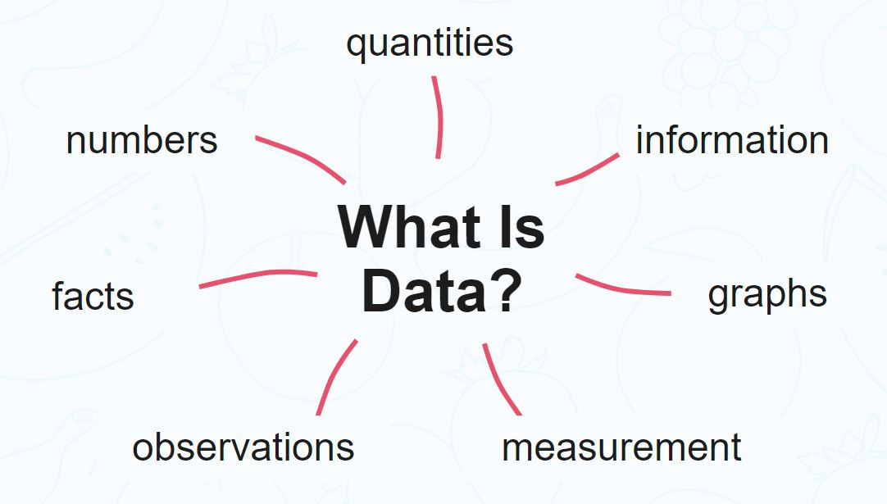
Success Metrics
Quantifiable Impact
We measure success not just by technical accuracy, but by the real-world impact on user autonomy, safety, and communication ability.
Comm. Initiation
Sovereignty Score
Coercion Incidents
Neural Coherence

Slide 34
Ethical Framework Governance
Principles for Ethical Neurotechnology
Non-Invasive First
Sovereign Comm. Rights
User safety is paramount. Our system is and will remain non-invasive.
Users have absolute control over their communication and interactions.
Family-Centered Consent
Open Peer Validation
Protocols involve families while preserving the user's ultimate agency.
Transparency and community oversight are required for accountability.

Slide 35
08
Call to Action

Slide 36

Call to Action
Join the Open Access Revolution
We are building more than technology; we are building a movement. A movement to empower neurodivergent voices with tools that respect their sovereignty and amplify their authenticity.
Contribute, collaborate, and help us build the future of ethical neurotech:
github.com/obinexus/bci

Slide 37
Contact & Next Steps
Get Involved Today
Website
GitHub
obinexus.org
github.com/obinexus
Email
Phone
research@obinexus.org
+44 07488 229054
"When systems fail to validate innovation, we build constitutional peer review infrastructure."

Slide 38

Key Innovation Summary
The OBINexus BCI system is a paradigm shift that moves beyond assistive technology to become a tool for authentic self-expression and sovereignty preservation.
Pre-conscious Detection: Identifies neural sparks before thought formation.
Puppet Relay Therapy: Enables non-coercive, authentic expression.
Constitutional Governance: Ensures ethics via open peer review.
T3A Access Model: Provides a framework for responsible, open development.

Slide 39





THANK YOU
OBINexus Open PeerReview BCI
2025/10/20

